Slide 1
COMP90054 AI Planning for Autonomy Workshop2

Slide 2
Objectives:
1. Properties of Heuristic Functions
2. Execution of Heuristic Search Algorithms
3. State Model

Slide 3
State Model
• State space S • Initial state s₀ ∈ S • Set of goal states s_{G} ⊆ S
• Applicable actions function A(s) for each state s ∈ S
• Transition function f (s, a) for s ∈ S and a ∈ A(s) • Cost of each action c(a, s) for s ∈ S and a ∈ A(s)

Slide 4
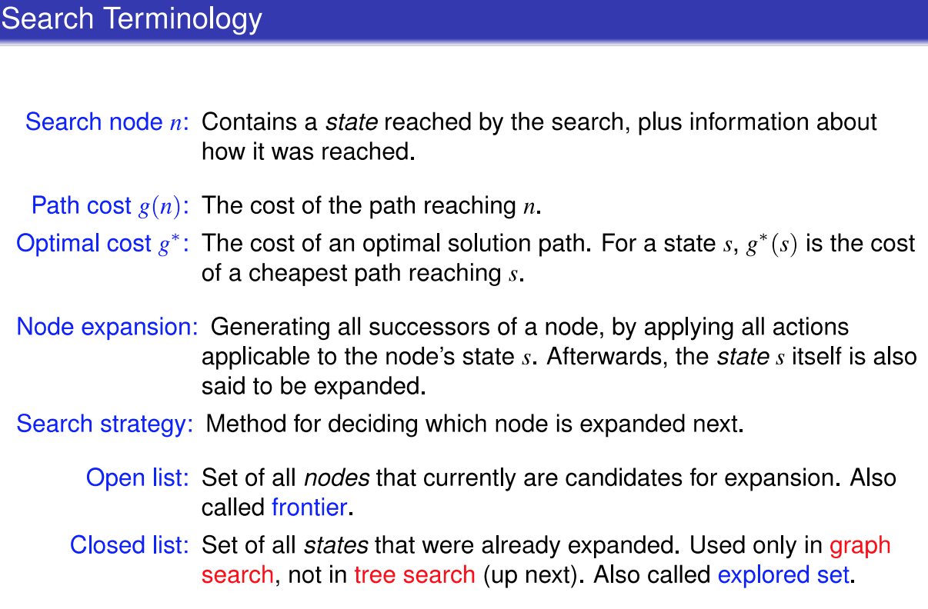

Slide 5
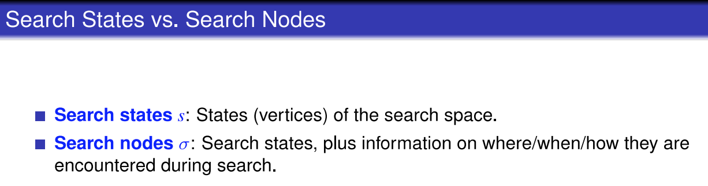

Slide 6
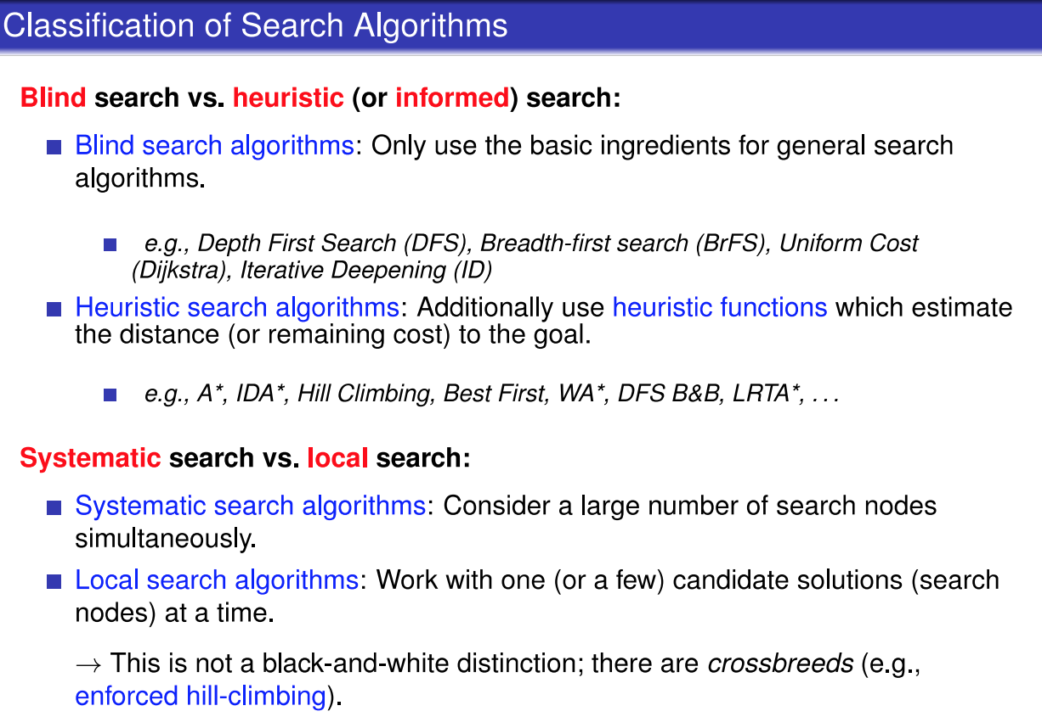

Slide 7
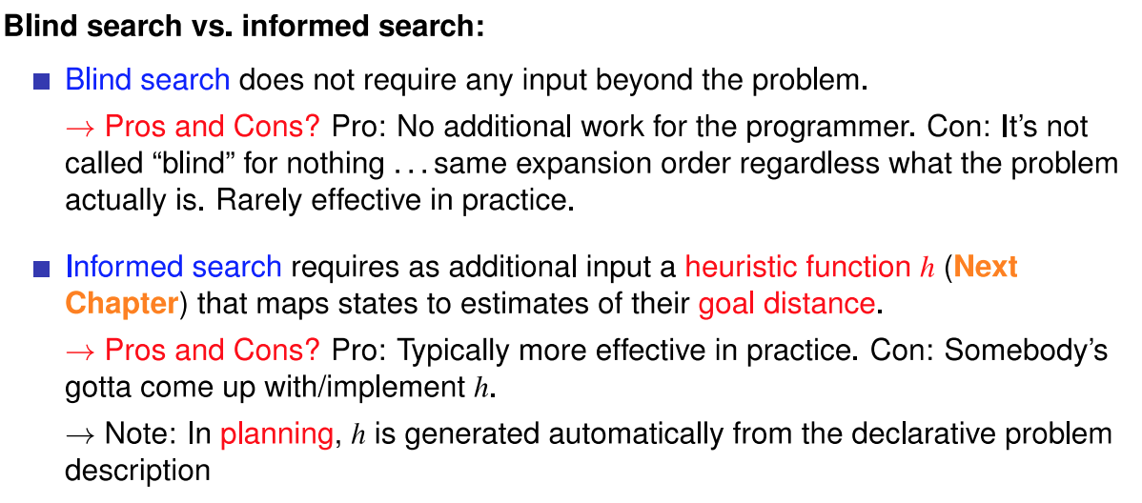

Slide 8
Heuristic Function
Heuristic searches require a heuristic function to estimate remaining cost.
Its value h(s) for a state s is referred to as the state’s heuristic value, or h-value
Remaining Cost (h∗) : is the cost of an optimal plan for s, or ∞ if there exists no plan for s, it is the perfect heuristic for a planning task

Slide 9
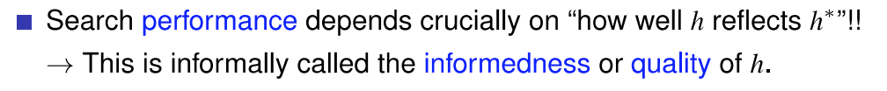
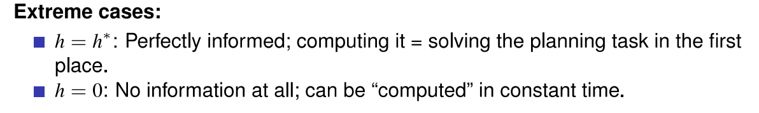

Slide 10
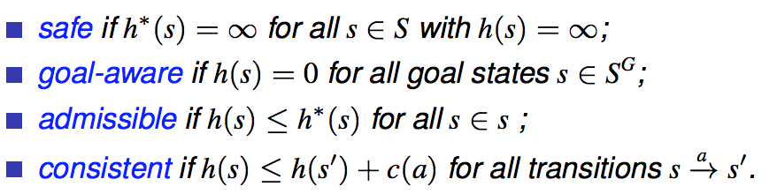
Properties of Heuristic Functions
consistent
goal-aware
admissible
goal-aware
safe

Slide 11
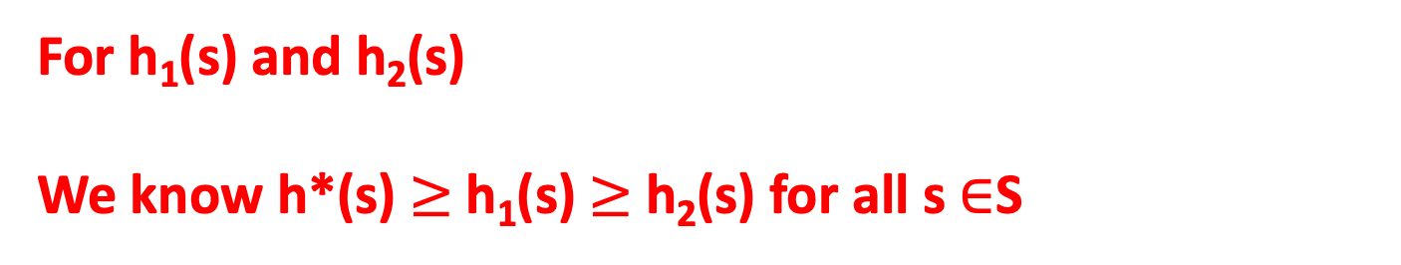
Dominate between two heuristics
For h₁(s) and h₂(s)
We know h*(s) $≥$h₁(s) $≥$h₂(s) for all s $∈$S

Slide 12
Data Structure: priority queue
ordered by f(s) value
A*
Weighted A* (WA*)
Greedy Best-First Search
f (s)= g(n) + h(s)
f(s) = g(n) + w*h(s)
f(s) = h(s)
f-value is used in priority queue
g-value is the accumulated cost from initial state to current state
h-value is the heuristic value of that state

Slide 13
Heuristic Search Algorithms :
Additionally use heuristic functions which estimate the distance (or remaining cost) to the goal.
A*
WA*
Enforced hill-climbing
Greedy Best First Search
Most popular algorithm in optimal planning
3 most popular algorithms in satisficing planning
If h is admissible, then we can guarantee the solution found by A* (that includes reopen in algorithm) is optimal
If h is admissible and consistent, then we can guarantee the solution found by A* (that didn’t include reopen) is optimal

Slide 14
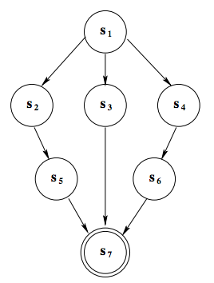
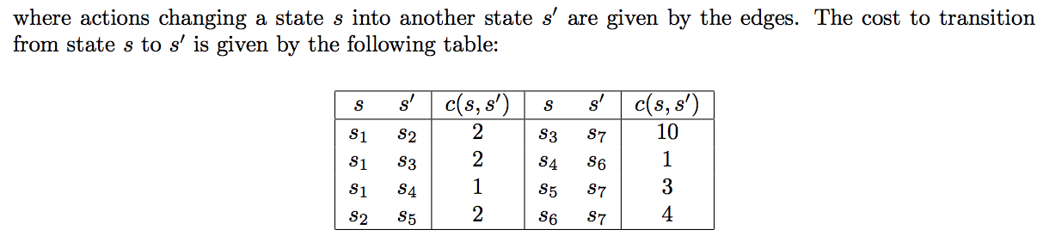
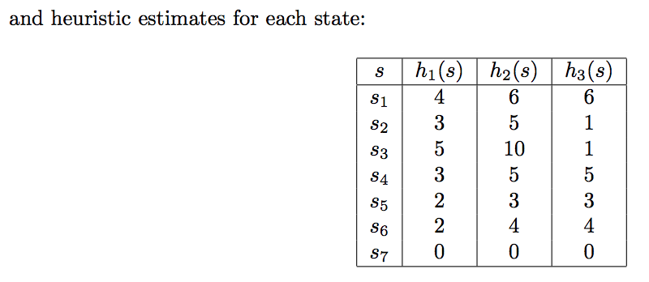
2
2
1
2
1
10
3
4

Slide 15

Question 1

Slide 16
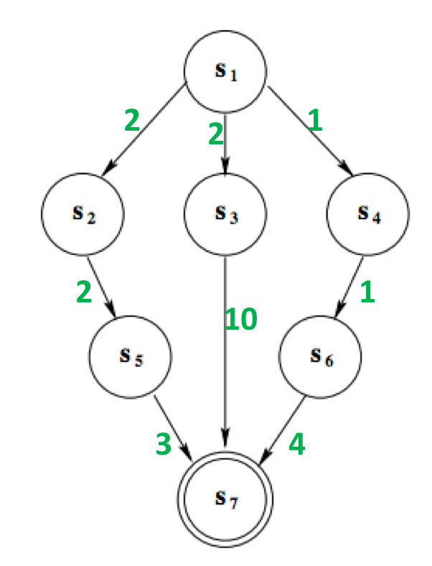


Calculate h*
s
h*(s)

Slide 17
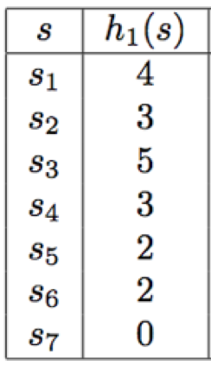
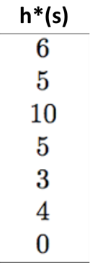



Question 1-1
<=
<=
<=
<=
<=
<=
<=
<=
<=
<=
<=
<=
<=
<=
<=
<=
<=
<=
<=
<=
<=
So, h1 is admissible
So, h2 is admissible
So, h3 is admissible

Slide 18
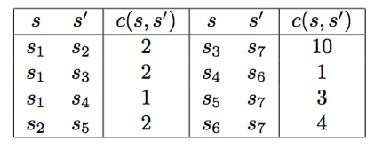
Question 1-2
Which heuristics are consistent?
4
h(s1) h(s2) + c(s1, s2)
2
1
<=
2
3
5
3
4
3
2
2
1
10
h(s1) h(s3) + c(s1, s3)
<=
2
2
3
4
4
5
2
and so on… …
0
So h1 is consistent

Slide 19
h2 is also consistent

Slide 20
h(s1) h(s2) + c(s1, s2)
>
6
1
2
So h3 is not consistent

Slide 21
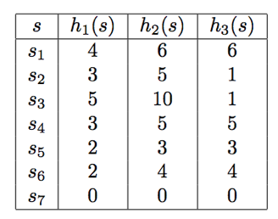
Question 1-3
Does any heuristic dominate any other?
h* dominates all other admissible heuristics
h2 = h* and therefore dominates all other admissible heuristics.
h1(s1) < h3(s1) and h3(s2) < h1(s2) and therefore neither of h1 and h3 dominate each other

Slide 22
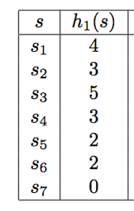
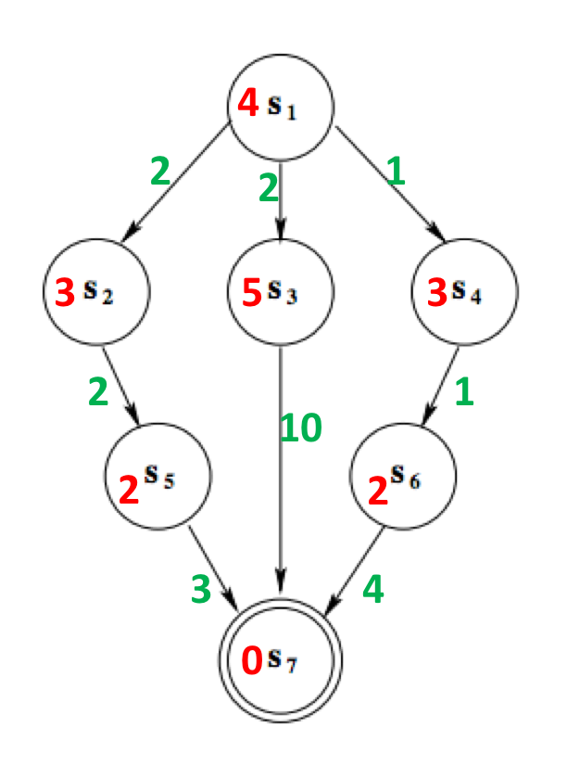
1.A*
Priority Queue ordered by f (s)= g(s) + h(s)
 | Iteration1 | Iteration2 | Iteration3
OPEN | n0=<S1,0,4,null> | n1=<s2,2,5,n0> n2=<s3,2,7,n0,> n3=<s4,1,4,n0,> | n5=<s6,2,4,n3> n1=<s2,2,5,n0> n2=<s3,2,7,n0,>
CLOSED |  | n0 | n0 n3

Slide 23
1.A*
Priority Queue ordered by f (s)= g(s) + h(s)
 | Iteration4 | Iteration5
OPEN | n6=<s7,6,6,n4> n1=<s2,2,5,n0> n2=<s3,2,7,n0,> | n6=<s7,6,6,n4> n2=<s3,2,7,n0,> n4=<s5,4,6,n1,>
CLOSED | n0 n3 n5 | n0 n3 n5 n1
Solution found by A* is : s1 → s4→ s6 →s7
This solution is optimal
Since n6 is at a goal state and has the lowest admissible cost of any node in the open list
All other paths from any other open node must be longer.

Slide 24
2.WA*
 | Iteration1 | Iteration2 | Iteration3
OPEN
CLOSED

Slide 25
2.WA*

Slide 26
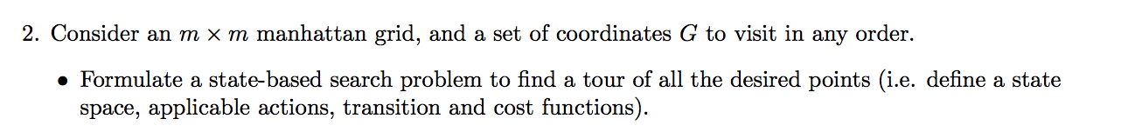
Question 2
Manhattan Grid
Moves: go up or down or left or right
one step

Slide 27
y
y
up
x
x
dy is the shift on y-axis
dx is the shift on x-axis

Slide 28


Question 2
Manhattan Grid
state space
Remaining coordinates
domain
V={(x,y)| x,y $∈$ {0….m}}
Already visited

Slide 29
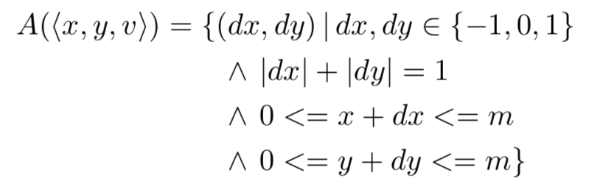

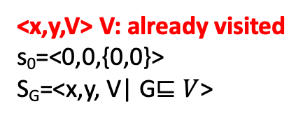
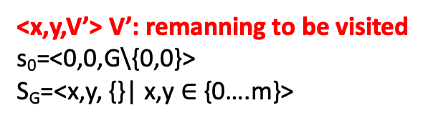
state space
Applicable actions function A(s) for each state s
Transition function
cost
<x,y,V’> V’: remanning to be visited
s₀=<0,0,G\{0,0}>
S_{G}=<x,y, {}| x,y $∈$ {0….m}>
<x,y,V> V: already visited
s₀=<0,0,{0,0}>
S_{G}=<x,y, V| G$⊑V$>

Slide 30
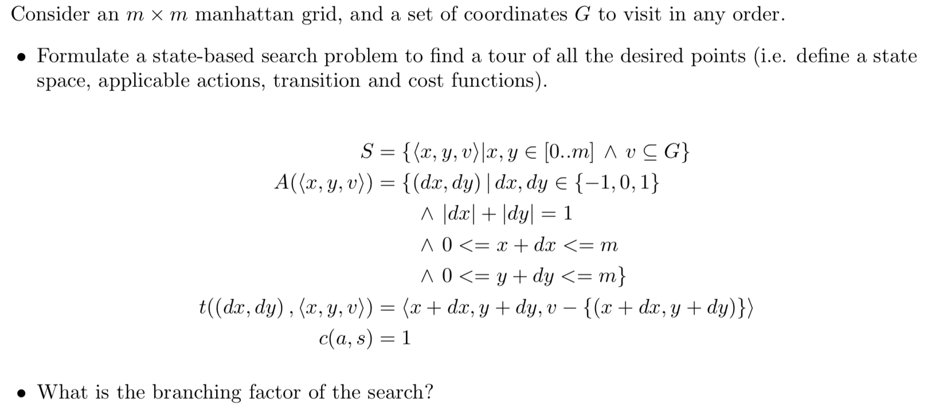
Approx 4

Slide 31
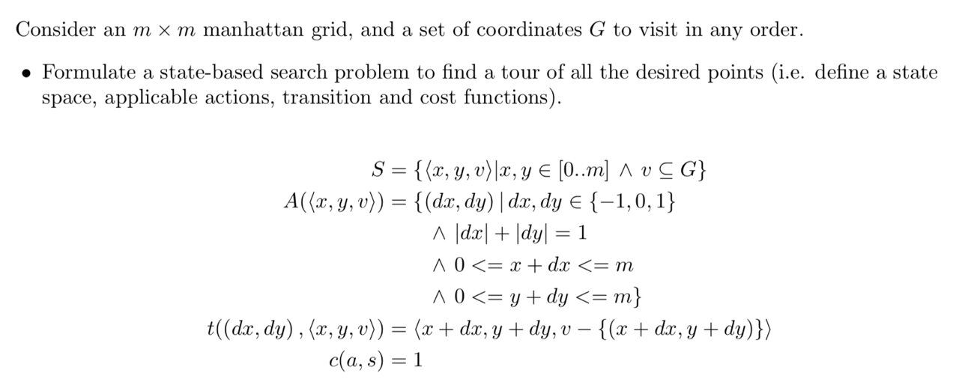
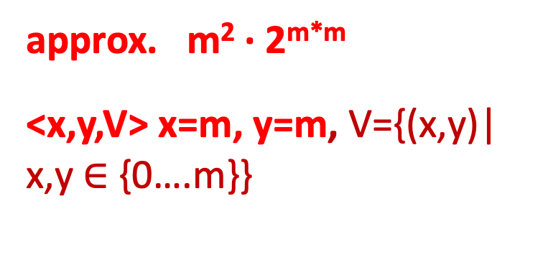
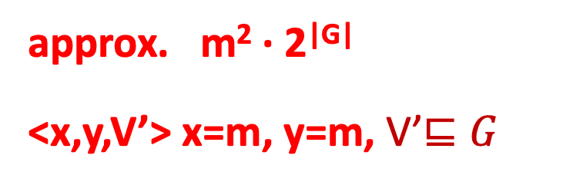
approx. m² · 2^{|G|}
<x,y,V’> x=m, y=m, V’$⊑G$
approx. m² · 2^{m*m}
<x,y,V> x=m, y=m, V={(x,y)| x,y $∈$ {0….m}}
Notes:
Absolute value of G’s power of 2

Slide 32
